Slide 1
JNVST - 2025
COMPLETE DETAILS OF THE ENTRANCE TEST EXAM

Slide 2
INTRODUCTION
In accordance with the National Policy of Education (1986), Government of India started Jawahar Navodaya Vidyalayas (JNVs). Presently the JNVs are spread in 27 States and 08 Union Territories. These are co-educational residential schools fully financed and administered by Government of India through an autonomous organization, Navodaya Vidyalaya Samiti. Admissions in JNVs are made through the JAWAHAR NAVODAYA VIDYALAYA SELECTION TEST (JNVST) to Class VI.

Slide 3
EXAM DATE AND TIME
On Saturday, 12th April, 2025 at 11.30 A.M. in the States of Jammu and Kashmir (except Jammu-I, Jammu-II & Samba), Meghalaya, Mizoram, Nagaland, Sikkim, and in the Districts of Dibang Valley and Tawang of Arunachal Pradesh, in the Districts of Chamba, Kinnaur, Mandi, Sirmour, Kullu, Lahaul & Spiti and Shimla of Himachal Pradesh, in the District of Darjeeling of West Bengal, and Leh & Kargil districts of UT Ladakh.

Slide 4
EXAM DATE AND TIME
On Saturday, 18th January, 2025 at 11.30 A.M. in the State of Andhra Pradesh, Assam, Arunachal Pradesh (except Dibang Valley & Tawang Districts), Bihar, Chhattisgarh, Goa, Gujarat, Haryana, Himachal Pradesh (except Chamba, Kinnaur, Mandi, Sirmour, Kullu, Lahaul & Spiti and Shimla Districts), Jammu & Kashmir (only for Jammu-I, Jammu-II & Samba) Jharkhand, Kerala, Karnataka, Madhya Pradesh, Maharashtra, Manipur, Orissa, Punjab, Rajasthan, Tripura, Telangana, Uttar Pradesh, Uttarakhand & West Bengal (except Darjeeling), Union Territories of Andaman & Nicobar Islands, Chandigarh, Dadar & Nagar Haveli, Daman & Diu, Delhi, Lakshadweep and Pudducherry.

Slide 5
Issue of Admit Cards
The admit cards will be made available as per date decided by NVS in due course which will be displayed on application portal. The admit cards shall be downloaded free of cost by the candidates/parents before the conduct of JNVST 2025.

Slide 6
Result of the Selection Test
The result of JNV Selection Test 2025 is expected to be announced by March, 2025 for Summer bound JNVs & in May, 2025 for Winter bound JNVs. Candidates can get the result from the application portal.

Slide 7
Result of the Selection Test
The result will also be displayed in the offices of the concerned:
Jawahar Navodaya Vidyalaya District
Education Officer
District Magistrate
Deputy Commissioner, Navodaya Vidyalaya Samiti of the Region.
The website of the Navodaya Vidyalaya Samiti www.navodaya.gov.in.
The Principal, Jawahar Navodaya Vidyalaya concerned, will also inform the provisionally selected candidates through SMS on the registered mobile number followed by a speed post.

Slide 8
DOCUMENTS TO BE SUBMITTED AFTER SELECTION
Proof for date of birth -The copy of Birth Certificate issued by competent Government Authority concerned.
Proofs for eligibility as per the conditions of NVS.
For candidates seeking admission under rural quota, the parents will also have to submit a certificate from the competent authority to the effect that the child had studied class III, IV and V in an Institution/ School located in a rural area.

Slide 9
DOCUMENTS TO BE SUBMITTED AFTER SELECTION
Residence Certificate: The valid residential proof (as notified Govt. of India) of the parent of the same District where the JNV is located & candidate has studied class V shall be furnished.
Copy of Aadhaar Card of the candidate: As per section 7 of Aadhaar act, 2016, the provisionally selected candidate has to submit the copy of Aadhaar Card to get admission under the Navodaya Vidyalaya Scheme.
Certificate by the Head Master of the school regarding study details of class III, IV & V.
Category/community certificate (SC/ST) if applicable. Category/community certificate OBC, as per central list if applicable.

Slide 10
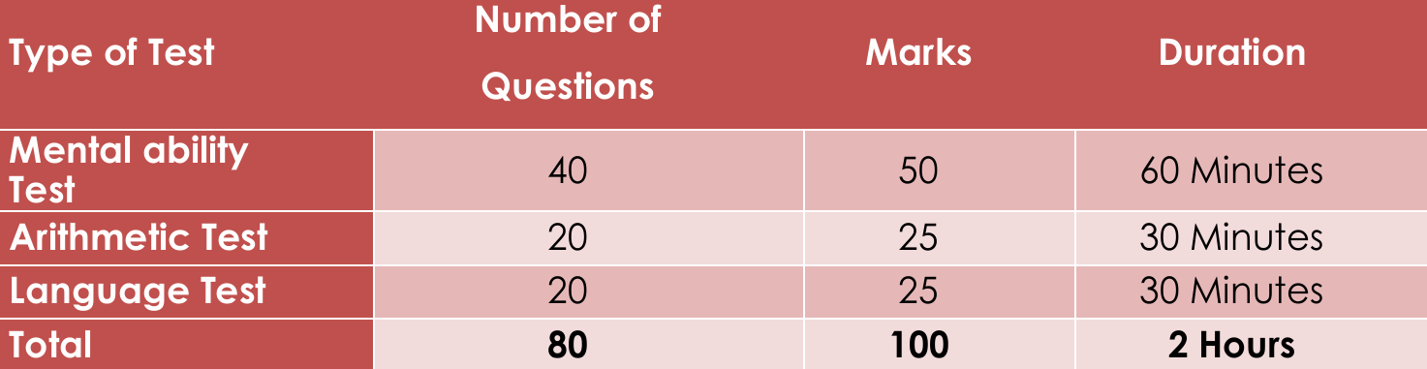
COMPOSITION OF THE SELECTION TEST

